Slide 1
MILK STATION
Submitted By,
Rejitha Ramesh
S3 MCA
Roll No : 17
Under the guidance of,
Prof. Elizabeth Paulose

Slide 2
Introduction
The main objective is to encourage dairy industries.
It is an application designed to manage activities related to people, their daily work such as collecting milk from members, sales to the customer and all the related processes.
Milk software also assists in reporting, and accounting.

Slide 3
Existing System
The manual system requires more time for processing.
The manual system is more error prone.
It is costly.
More men power needed.

Slide 4
Proposed System
This system required less time for completion of any work.
This system has reduced chances of error
This system will work smoothly and very fast.
This system will save time and manpower.

Slide 5
Module Description
Login
Milk Collection
Milk Sale & Milk Products
Payments
Report

Slide 6
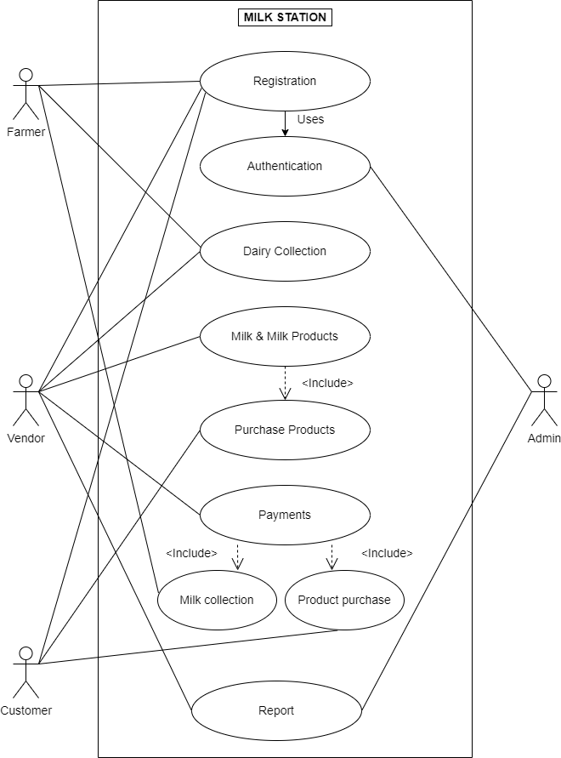
Use Case Model

Slide 7
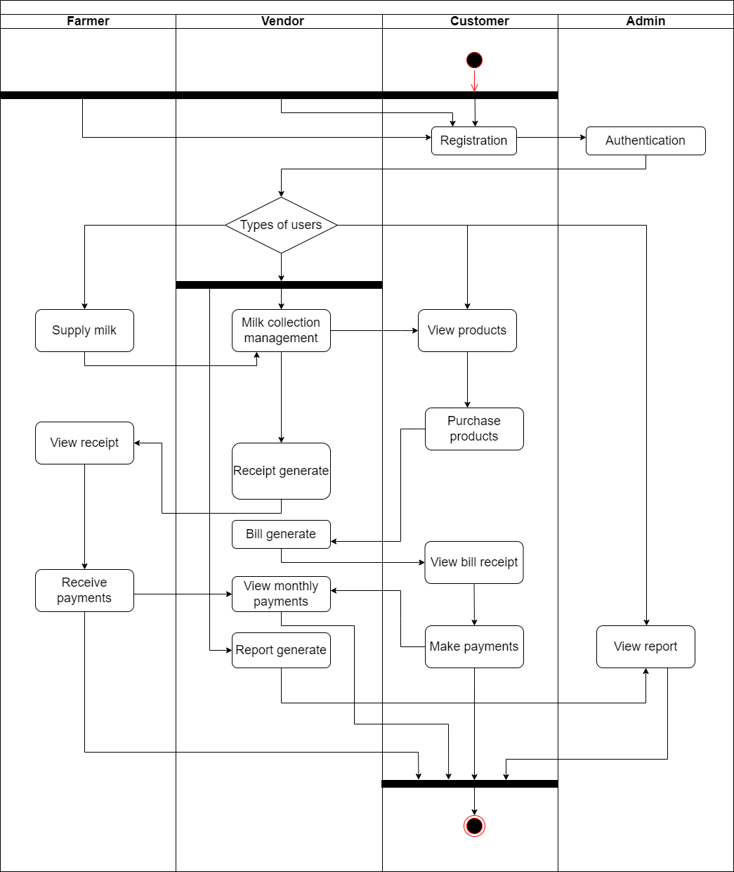
Activity Diagram

Slide 8
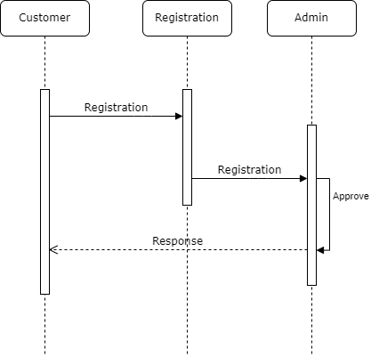
Sequence Diagram For Registration

Slide 9
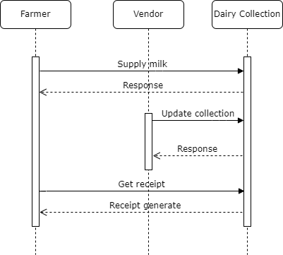
Sequence Diagram For Collection Details

Slide 10
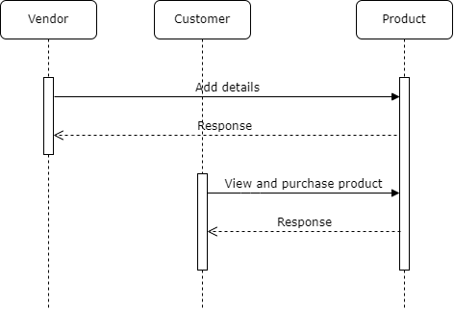
Sequence Diagram For Purchase

Slide 11
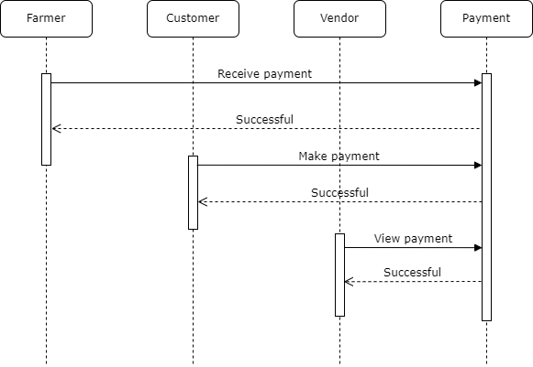
Sequence Diagram For Payment

Slide 12
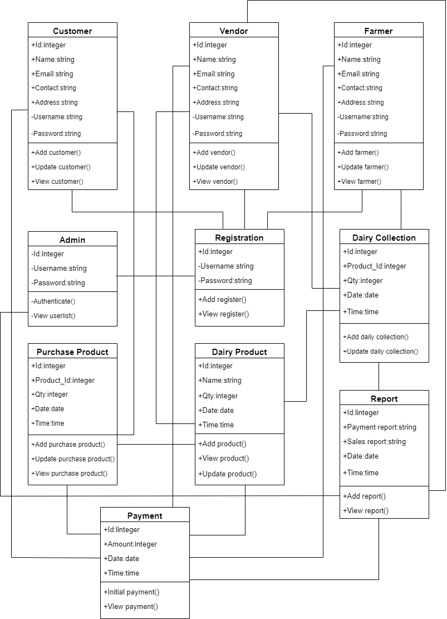
Class Diagram

Slide 13
Database Design
Table name:- Admin
Description:- To store admin details
Field name | Data type | Description | Constrains
admin_id | Int(20) | Id for admin | Primary key
Username | varchar(100) | Username for admin | Not null
Password | Varchar(100) | Password for admin | Not null
Table name:- Customer
Description:- To store customer details
Field name | Data type | Description | Constrains
Cust_id | Int(20) | Id for customer | Primary key
name | varchar(100) | Name for customer | Not null
contact | varchar(100) | Contact number of customer | Not null
gender | varchar(100) | Gender of customer | Not null
Proof | Blob | Proof of customer | Not null
username | varchar(100) | Username for customer | Not null
password | varchar(100) | Password for customer | Not null
place_id | Int(20) | Place id of customer | Foreign key

Slide 14
Table name:- Vendor
Description:- To store vendor details
Field name | Data type | Description | Constrains
vendor_id | Int(20) | Id for vendor | Primary key
name | varchar(100) | Name for vendor | Not null
contact | varchar(100) | Contact number of vendor | Not null
gender | varchar(100) | Gender of vendor | Not null
Proof | Blob | Proof of vendor | Not null
photo | Blob | Photo of vendor | Not null
location_id | Int(20) | Location id of vendor | Foreign key
username | Varchar(100) | username for vendor | Not null
password | Varchar(100) | password for vendor | Not null
License no | int(20) | License number of vendor | Not null

Slide 15
Table name:- Farmer
Description:- To store farmer details
Field name | Data type | Description | Constrains
farmer_id | Int(20) | Id for farmer | Primary key
name | varchar(100) | Name for farmer | Not null
contact | varchar(100) | Contact number of farmer | Not null
gender | varchar(100) | Gender of farmer | Not null
Proof | Blob | Proof of farmer | Not null
photo | Blob | Photo of farmer | Not null
location_id | Int(20) | Location id of farmer | Foreign key
username | Varchar(100) | username for farmer | Not null
password | Varchar(100) | password for farmer | Not null

Slide 16
Table name:- Product
Description:- To store product details
Field name | Data type | Description | Constrains
product_id | Int(20) | Id for product | Primary key
Product type_id | Int(20) | Product type Id for product | Foreign key
name | varchar(100) | name of product | Not null
description | varchar(100) | description of product | Not null
image | Blob | image of product | Not null
Amount | double | Amount of product | Not null
Table name:- Product type
Description:- To store product type details
Field name | Data type | Description | Constrains
Product type_id | Int(20) | Id for product type | Primary key
Product type name | Varchar(100) | Name for product type | Not null

Slide 17
Table name:- Place
Description:- To store place details
Field name | Data type | Description | Constrains
Place_id | Int(20) | Id for place | Primary key
Place_name | Varchar(100) | Name for place | Not null
Table name:- Location
Description:- To store location details
Field name | Data type | Description | Constrains
location_id | Int(20) | Id for location | Primary key
Location_ name | Varchar(100) | Name for location | Not null
Table name:- Dairy collection
Description:- To dairy collection details
Field name | Data type | Description | Constrains
dc_id | Int(20) | Id for dairy collection | Primary key
dc_milk amount | Double | Amount of dairy collection | Not null
Contact_id | Int(20) | id of contact | Foreign key
dc_date | Date | date for dairy collection | Not null
dc_time | Time | Time for dairy collection | Not null

Slide 18
Table :- 9
Description:- To store contact details
Field name | Data type | Description | Constrains
purchase_id | Int(20) | Id for purchase product | Primary key
purchase_qty | Double | Quantity of milk | Not null
purchase_date | Date | Date for purchase product | Not null
purchase_time | Time | Time for purchase product | Not null
purchase_amount | Double | Amount of milk | Not null
product_id | Int(20) | Id for product | Foreign key
product type_id | Int(20) | Id for product type | Foreign key
customer_id | Int(20) | Id for customer | Foreign key
Table :- 10
Description:- To store payment details
Field name | Data type | Description | Constrains
payment_id | Int(20) | Id for payment | Primary key
payment_date | Date | Date for payment | Not null
payment_time | time | Time for payment | Not null
dc_id | Int(20) | Id for dairy collection | Foreign key
dc_milk quantity status | Double | Quantity of milk | Foreign key
purchase_id | Int(20) | Id for purchase product | Foreign key
purchase_amount | Double | Amount of milk | Foreign key
vendor_id | Int(20) | Id for vendor | Foreign key
farmer_id | Int(20) | Id for farmer | Foreign key
customer_id | Int(20) | Id for customer | Foreign key

Slide 19
Table :- 11
Description:- To store report details
Field name | Data type | Description | Constrains
report_id | Int(20) | Id for report | Primary key
report_date | Date | Date for report | Not null
report_time | time | Time for report | Not null
description | Varchar(100) | Description of report | Not null
vendor_id | Int(20) | Id for vendor | Foreign key
admin_id | Int(20) | Id for admin | Foreign key
purchase_id | Int(20) | Id for purchase product | Foreign key
payment_id | Int(20) | Id for payment | Foreign key
dc_id | Int(20) | Id for dairy collection | Foreign key

Slide 20
THANK YOU…

